Slide 1
STELLAR ACADEMY
PLACEMENT
JAVA FULL STACK PROJECT
DEEN’S MOVIE VAULT
By :
43110197 - Deenprasath S, III B.E (CSE) Sathyabama Institute of Science and Technology

Slide 2
AGENDA
ABSTRACT
PROPOSED SYSTEM
ARCHITECTURE DIAGRAM
PROS & CONS
REQUIREMENTS
MODULES
SAMPLE OUTPUT
CONCLUSION

Slide 3
ABSTRACT
Developed a full-stack web application for organizing and visualizing a movie catalog.
Utilized React.js (frontend) and Spring Boot with MongoDB (backend) for seamless, dynamic user experience.
The system offers genre-based search, IMDB/trailer integration, and responsive, modern UI design.
Solves the drawbacks of manual cataloging and static lists by providing efficient, interactive features for users.

Slide 4
Proposed system
The proposed system is a full-stack movie catalog web application utilizing React for the user interface and Spring Boot with MongoDB for backend data management.
It allows users to efficiently search, filter, and view movies by genre, title, IMDb ID, and provides direct access to trailer links.
The platform features a visually appealing, responsive design with dynamic screenshots, genre badges, and a designer badge for enhanced user experience.
By offering seamless integration between frontend and backend, the system overcomes limitations of static/manual cataloging, ensuring modern, interactive, and scalable performance.

Slide 5
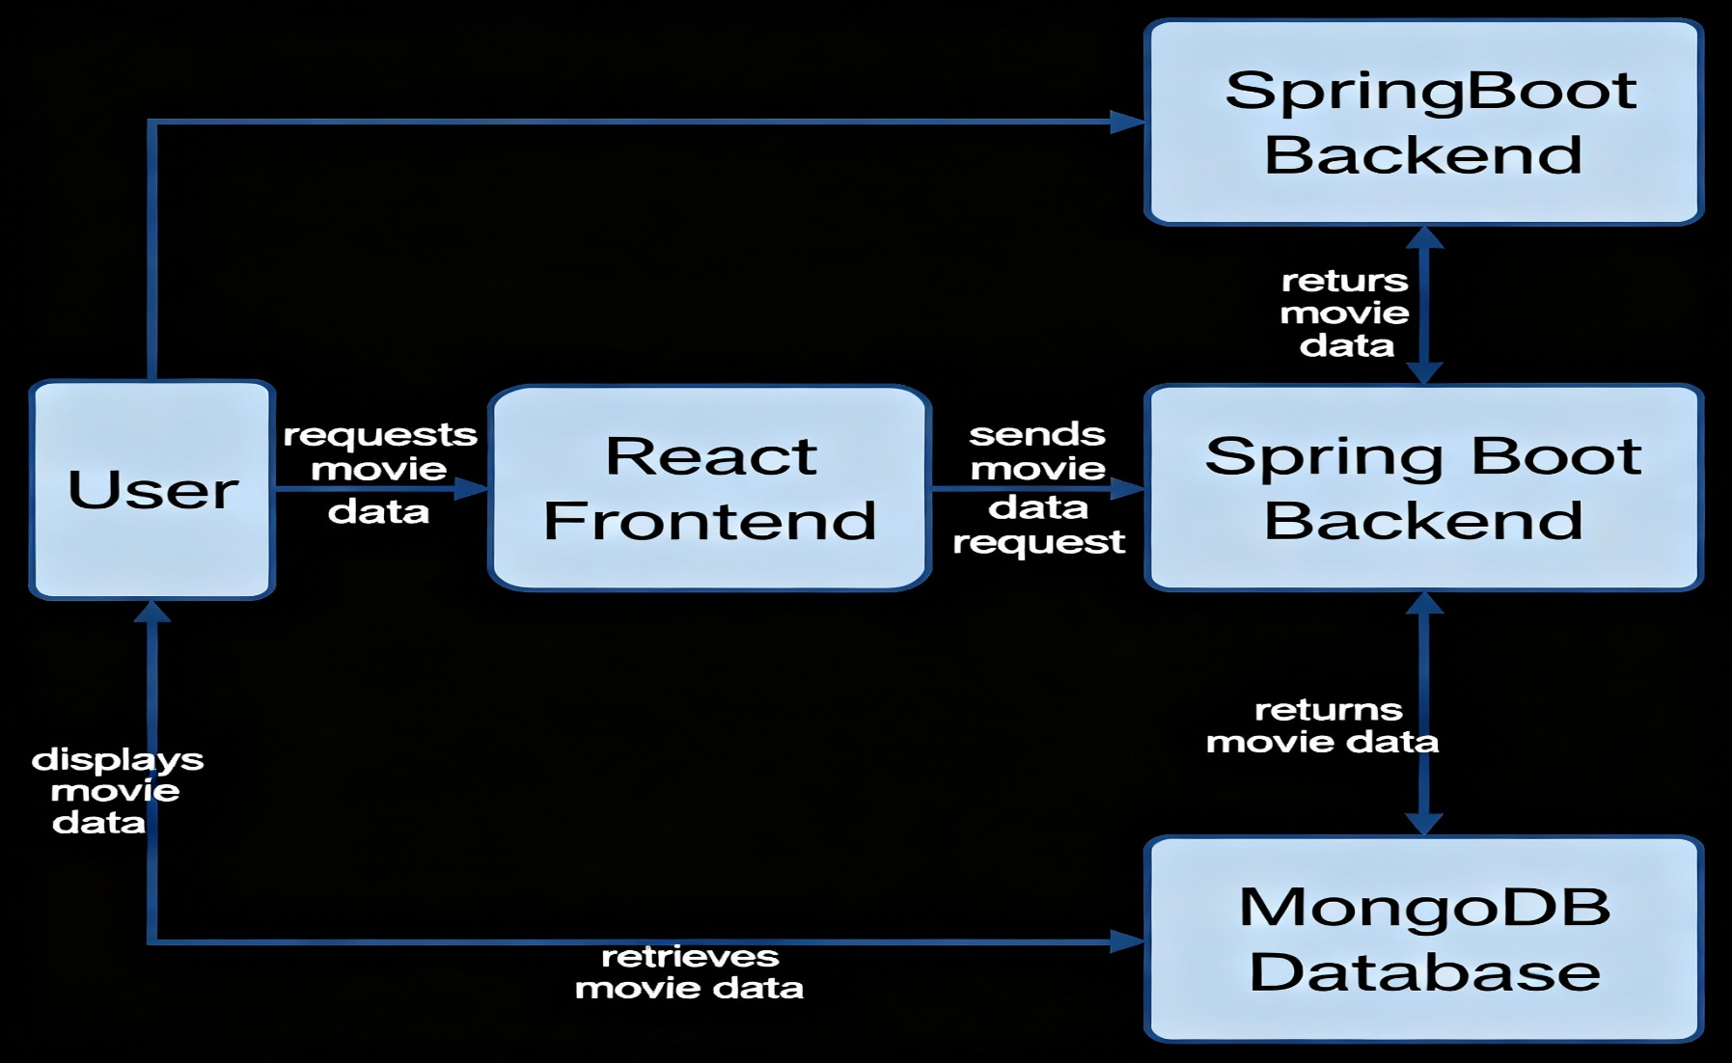
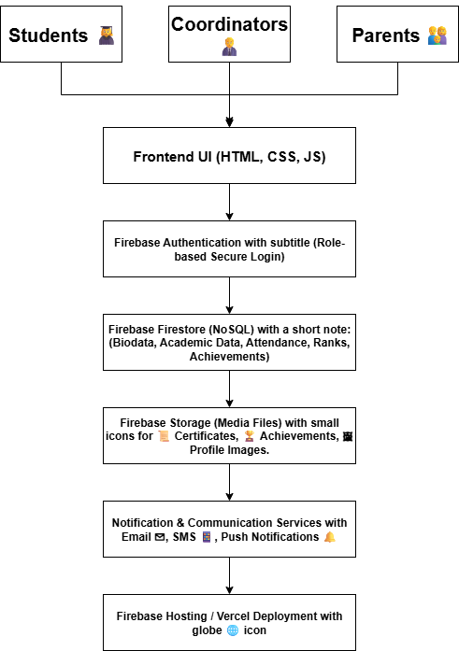
ARCHITECTURE

Slide 6
Pros and Cons
Advantages (Pros):
Provides an interactive, modern UI for browsing, searching, and filtering movie collections.
Enables seamless integration of frontend (React) and backend (Spring Boot) technologies, teaching full-stack skills.
Uses MongoDB for efficient, scalable storage of large movie datasets.
Offers features like IMDB integration, genre tags, and trailer links for enhanced user experience. Disadvantages (Cons):
Requires both frontend and backend environments to be set up and run, increasing deployment complexity.
Relies on internet connectivity for external resources (trailers/IMDB links).
Application scalability or performance may need optimization for extremely large datasets or high concurrent users

Slide 7
Requirements and Modules
Software Requirements
React.js for frontend interface development
Spring Boot framework for backend API and business logic
MongoDB for NoSQL database storage and management
Node.js and npm for frontend tooling, with Java 17+ for backend execution
Main Modules
User Interface Module: Movie browsing, search, genre filtering, and responsive visual layout
Backend API Module: Movie data retrieval, storage, CRUD operations, and RESTful services
Database Module: Movie details storage, genre mapping, and poster/trailer URL management in MongoDB
External Integration Module: IMDB info and trailer link integration for enhanced movie discovery experience

Slide 8
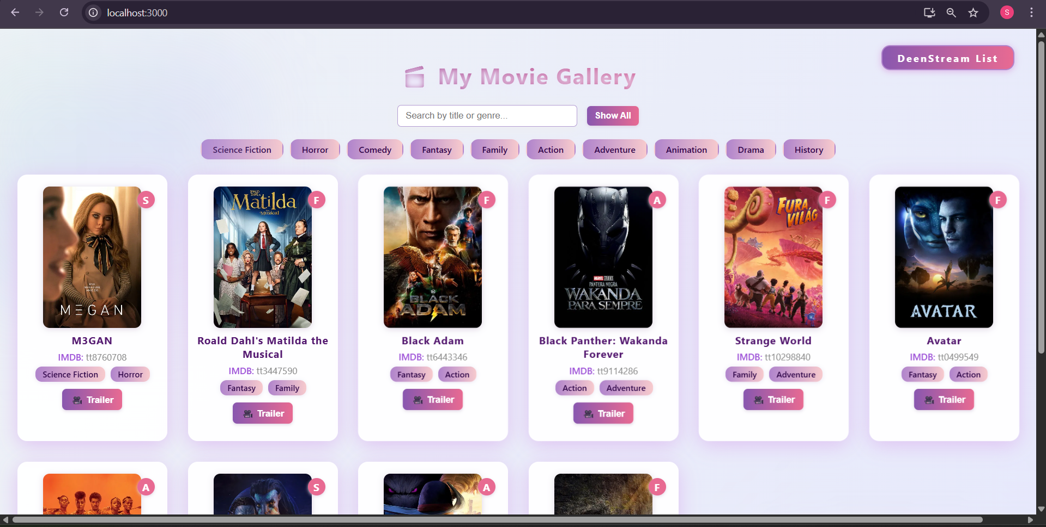
Sample output(Screenshot)

Slide 9
Conclusion
The movie gallery web application successfully demonstrates the integration of modern frontend and backend technologies for an interactive user experience.
Efficient data management, real-time search, and external resource integration (IMDB/trailer links) make the platform practical for both users and developers.
The project workflow, modular structure, and use of scalable tools equip learners for professional full-stack development tasks.
Future enhancements could include user accounts, recommendations, and advanced analytics to further expand the system’s capabilities

Slide 10
THANK YOU

